Slide 1
WELCOME

Slide 2
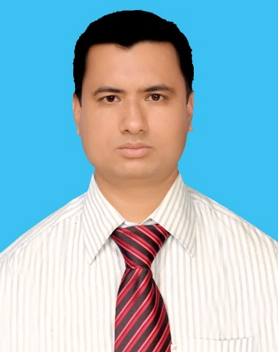
INTRODUCTION
MD. ZAMINUR ISLAM KHANDAKAR
Assi. Teacher [English]
ATI DASHRA GHUGOIL DAKHIL MADRASA.
Manjhar Bazar, Khetlal, Joypurhat.
Contact: 01720-690285

Slide 3
Today’s Lesson Completing Story
Robert Bruce
For the students of class 6 to 10

Slide 4
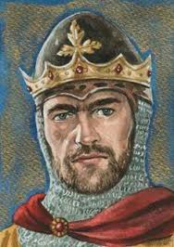
A long time ago, there was a king named Robert Bruce.

Slide 5
He was very brave and powerful.

Slide 6
His kingdom was in Scotland.

Slide 7
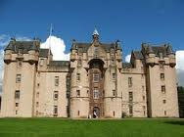
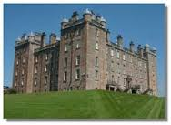
He had a nice palace.

Slide 8
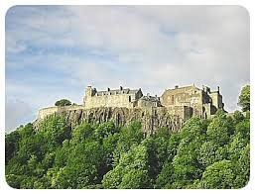
He lived there in peace.

Slide 9
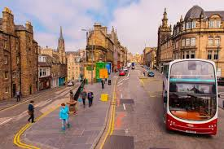
All lived happily.

Slide 10
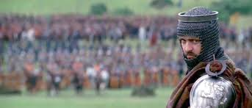
But suddenly one day, his enemies attacked his kingdom.

Slide 11
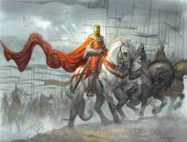
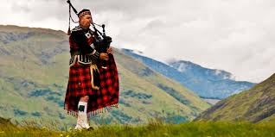
His enemies were more powerful than he.

Slide 12
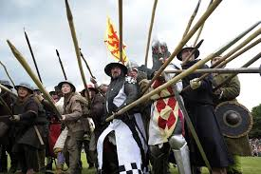
The enemies attacked his kingdom.

Slide 13
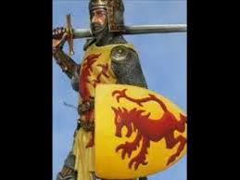
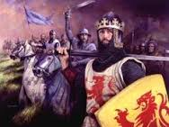
Bruce was ready to fight against them.

Slide 14
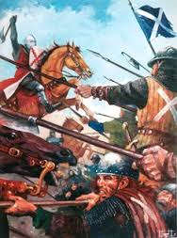
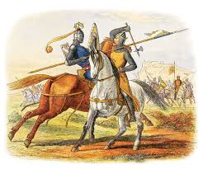
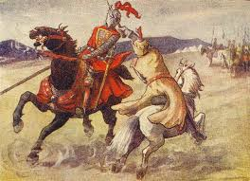
A fierce battle took place.

Slide 15
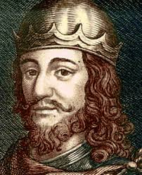
Robert Bruce was
defeated
in the battle.

Slide 16
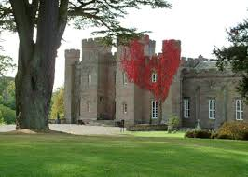
He lost his kingdom.

Slide 17
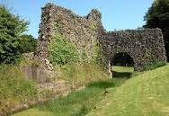
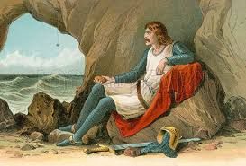
He escaped from the battle field to save his life
and took shelter in an old fort’s cave.

Slide 18
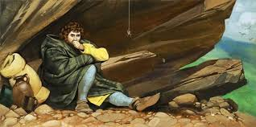
He was very depressed and wanted to regain his kingdom.

Slide 19
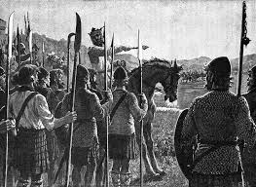
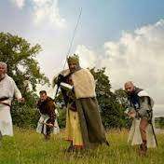
He tried to gather army.

Slide 20
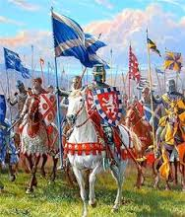
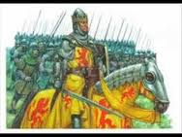
With his army, he attacked his enemies.

Slide 21
But unfortunately, he was defeated again.

Slide 22
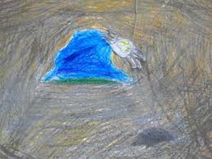
He tried six times but every time he was unsuccessful.
He took shelter in the cave again and again.

Slide 23
He was hopeless.

Slide 24
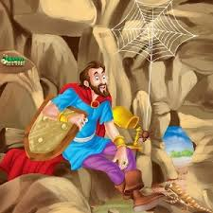
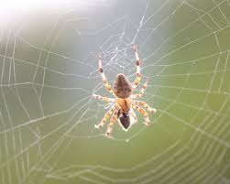
One day when he was lying in his cave, he saw a spider.
The spider was trying to reach the celling to climb his web. It tried again and again but each time it failed. But after six attempts, the spider succeeded to reach its destination.

Slide 25
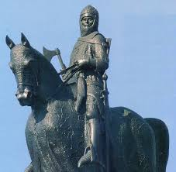
This incident inspired him very much. He saw the light of hope.
He tried to fight again.

Slide 26
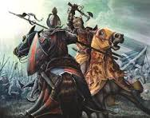
He attacked his enemies and fought bravely.

Slide 27
This time he defeated his enemies.

Slide 28
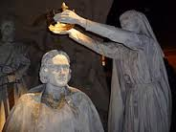
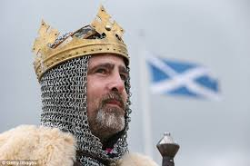
And got back his kingdom.

Slide 29
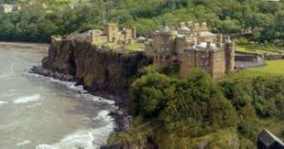
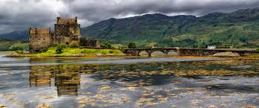
Since then, he again began to live there happily.

Slide 30
What did you learn from the story?
“Failure is the pillar of success.”

Slide 31
Thank you for watching this presentation.
Please vote this presentation in Shikkhok Batayon.

Slide 32
The End

